Slide 1
Chapter 3
Wireless LANs
Reading materials:
1.第8章、第9章[1]，Part 4 in [2]
2.M. Ergen (UC Berkeley), 802.11 tutorial

Slide 2
Outline
3.1 Wireless LAN Technology
3.2 Wireless MAC
3.3 IEEE 802.11 Wireless LAN Standard
3.4 Bluetooth

Slide 3
3.1 Wireless LAN Technology
3.1.1 Overview
3.1.2 Infrared LANs
3.1.3 Spread Spectrum LANs
3.1.4 Narrowband Microwave LANs

Slide 4
3.1.1 Overview
WLAN Applications
WLAN Requirements
WLAN Technology

Slide 5
3.1.1.1 Wireless LAN Applications
LAN Extension
Cross-building interconnect
Nomadic Access
Ad hoc networking

Slide 6
LAN Extension
Wireless LAN linked into a wired LAN on same premises
  Wired LAN
    Backbone
    Support servers and stationary workstations
  Wireless LAN
    Stations in large open areas
    Manufacturing plants, stock exchange trading floors, and warehouses

Slide 7
Cross-Building Interconnect
Connect LANs in nearby buildings
  Wired or wireless LANs
Point-to-point wireless link is used
Devices connected are typically bridges or routers

Slide 8
Nomadic Access
Wireless link between LAN hub and mobile data terminal equipped with antenna
  Laptop computer or notepad computer
Uses:
  Transfer data from portable computer to office server
  Extended environment such as campus

Slide 9
Ad Hoc Networking
Temporary peer-to-peer network set up to meet immediate need
Example:
  Group of employees with laptops convene for a meeting; employees link computers in a temporary network for duration of meeting

Slide 10
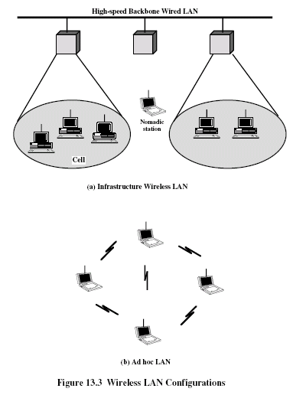

Slide 11
3.1.1.2 Wireless LAN Requirements
Throughput
Number of nodes
Connection to backbone LAN
Service area
Battery power consumption
Transmission robustness and security
Collocated network operation
License-free operation
Handoff/roaming
Dynamic configuration

Slide 12
3.1.1.3 Wireless LAN Technology
Infrared (IR) LANs
Spread spectrum LANs
Narrowband microwave

Slide 13
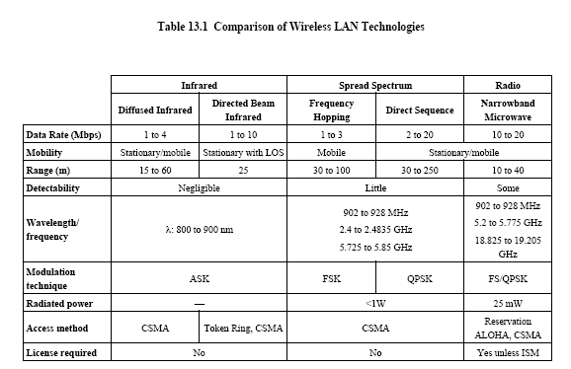

Slide 14
3.1.2 Infrared LANs
Strengths and Weakness
Transmission Techniques

Slide 15
Strengths of Infrared Over Microwave Radio
Spectrum for infrared virtually unlimited
  Possibility of high data rates
Infrared spectrum unregulated
Equipment inexpensive and simple
Reflected by light-colored objects
  Ceiling reflection for entire room coverage
Doesn’t penetrate walls
  More easily secured against eavesdropping
  Less interference between different rooms

Slide 16
Drawbacks of Infrared Medium
Indoor environments experience infrared background radiation
  Sunlight and indoor lighting
  Ambient radiation appears as noise in an infrared receiver
  Transmitters of higher power required
    Limited by concerns of eye safety and excessive power consumption
  Limits range

Slide 17
IR Data Transmission Techniques
Directed Beam Infrared
Ominidirectional
Diffused

Slide 18
Directed Beam Infrared
Used to create point-to-point links (e.g.Fig.13.5)
Range depends on emitted power and degree of focusing
Focused IR data link can have range of kilometers
  Such ranges are not needed for constructing indoor WLANs
  Cross-building interconnect between bridges or routers

Slide 19
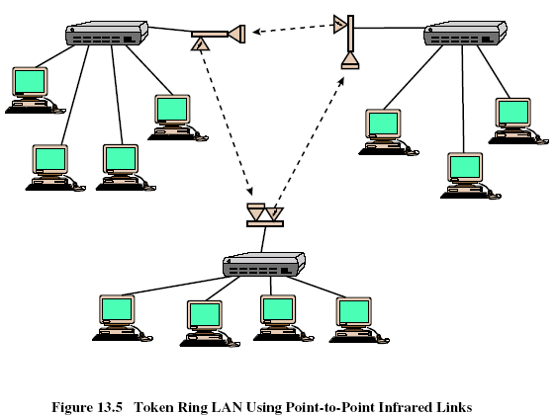

Slide 20
Ominidirectional
Single base station within line of sight of all other stations on LAN
Base station typically mounted on ceiling (Fig.13.6a)
Base station acts as a multiport repeater
  Ceiling transmitter broadcasts signal received by IR transceivers
  Other IR transceivers transmit with directional beam aimed at ceiling base unit

Slide 21
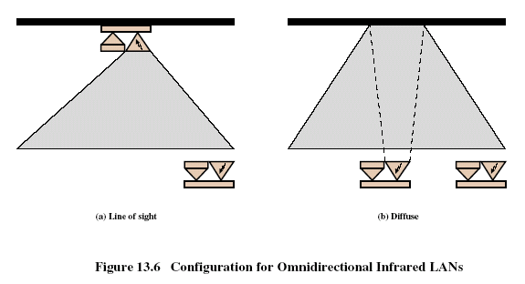

Slide 22
Diffused
All IR transmitters focused and aimed at a point on diffusely reflecting ceiling (Fig.13.6b)
IR radiation strikes ceiling
  Reradiated omnidirectionally
  Picked up by all receivers

Slide 23
Typical Configuration for IR WLANs
Fig.13.7 shows a typical configuration for a wireless IR LAN installation
A number of ceiling-mounted base stations, one to a room
Using ceiling wiring, the base stations are all connected to a server
Each base station provides connectivity for a number of stationary and mobile workstations in its area

Slide 24
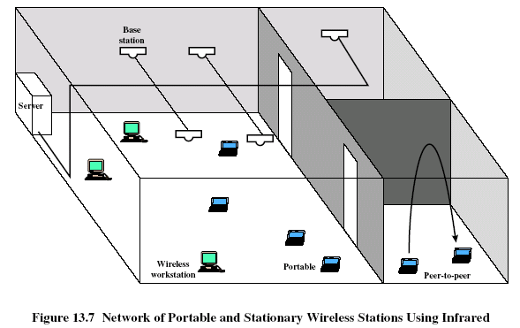

Slide 25
3.1.3 Spread Spectrum LANs
Configuration
Transmission Issues

Slide 26
3.1.3.1 Configuration
Multiple-cell arrangement
Within a cell, either peer-to-peer or hub
Peer-to-peer topology
  No hub
  Access controlled with MAC algorithm
    CSMA
  Appropriate for ad hoc LANs

Slide 27
Spread Spectrum LAN Configuration
Hub topology
  Mounted on the ceiling and connected to backbone
  May control access
  May act as multiport repeater
  Automatic handoff of mobile stations
  Stations in cell either:
    Transmit to / receive from hub only
    Broadcast using omnidirectional antenna

Slide 28
3.1.3.2 Transmission Issues
Within ISM band, operating at up to 1 watt.
Unlicensed spread spectrum: 902-928 MHz (915 MHZ band), 2.4-2.4835 GHz (2.4 GHz band), and 5.725-5.825 GHz (5.8 GHz band). The higher the frequency, the higher the potential bandwidth

Slide 29
3.1.4 Narrowband Microwave LANs
Use of a microwave radio frequency band for signal transmission
Relatively narrow bandwidth
Licensed
Unlicensed

Slide 30
Licensed Narrowband RF
Licensed within specific geographic areas to avoid potential interference
Motorola - 600 licenses (1200 frequencies) in 18-GHz range
  Covers all metropolitan areas
  Can assure that independent LANs in nearby locations don’t interfere
  Encrypted transmissions prevent eavesdropping

Slide 31
Unlicensed Narrowband RF
RadioLAN introduced narrowband wireless LAN in 1995
  Uses unlicensed ISM spectrum
  Used at low power (0.5 watts or less)
  Operates at 10 Mbps in the 5.8-GHz band
  Range = 50 m to 100 m

Slide 32
3.2 Wireless MAC

Slide 33
Wireless Data Networks
Experiencing a tremendous growth over the last decade or so
Increasing mobile work force, luxury of tetherless computing, information on demand anywhere/anyplace, etc, have contributed to the growth of wireless data

Slide 34
Wireless Network Types …
Satellite networks
  e.g. Iridium (66 satellites), Qualcomm’s Globalstar (48 satellites)
Wireless WANs/MANs
  e.g. CDPD, GPRS, Ricochet
Wireless LANs
  e.g. Georgia Tech’s LAWN
Wireless PANs
  e.g. Bluetooth
Ad-hoc networks
  e.g. Emergency relief, military
Sensor networks

Slide 35
Wireless Local Area Networks
Probably the most widely used of the different classes of wireless data networks
Characterized by small coverage areas (~200m), but relatively high bandwidths (upto 50Mbps currently)
Examples include IEEE 802.11 networks, Bluetooth networks, and Infrared networks

Slide 36
WLAN Topology
Static host/Router
Distribution Network
Access Point
Mobile
Stations

Slide 37
Wireless WANs
Large coverage areas of upto a few miles radius
Support significantly lower bandwidths than their LAN counterparts (upto a few hundred kilobits per second)
Examples: CDPD, Mobitex/RAM, Ricochet

Slide 38
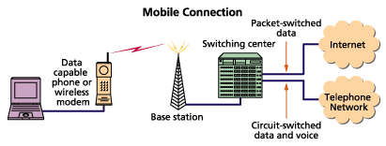
WAN Topology

Slide 39
Wireless MAC
Channel partitioning techniques
  FDMA, TDMA, CDMA
Random access

Slide 40
Wireline MAC Revisited
ALOHA
slotted-ALOHA
CSMA
CSMA/CD
Collision free protocols
Hybrid contention-based/collision-free protocols

Slide 41
Wireless MAC
CSMA as wireless MAC?
Hidden and exposed terminal problems make the use of CSMA an inefficient technique
Several protocols proposed in related literature – MACA, MACAW, FAMA
IEEE 802.11 standard for wireless MAC

Slide 42
Hidden Terminal Problem
Collision
A
B
C
A talks to B
C senses the channel
C does not hear A’s transmission (out of range)
C talks to B
Signals from A and B collide

Slide 43
Exposed Terminal Problem
Not
possible
A
B
C
D
B talks to A
C wants to talk to D
C senses channel and finds it to be busy
C stays quiet (when it could have ideally transmitted)

Slide 44
Hidden and Exposed Terminal Problems
Hidden Terminal
  More collisions
  Wastage of resources
Exposed Terminal
  Underutilization of channel
  Lower effective throughput

Slide 45
MACA
Medium Access with Collision Avoidance
Inspired by the CSMA/CA method used by Apple Localtalk network (for somewhat different reasons)
CSMA/CA (Localtalk) uses a “dialogue” between sender and receiver to allow receiver to prepare for receptions in terms of allocating buffer space or entering “spin loop” on a programmed I/O interface

Slide 46
Basis for MACA
In the context of hidden terminal problem, “absence of carrier does not always mean an idle medium”
In the context of exposed terminal problem, “presence of carrier does not always mean a busy medium”
Data carrier detect (DCD) useless!
Get rid of CS (carrier sense) from CSMA/CA – MA/CA – MACA!!!!

Slide 47
MACA
Dialogue between sender and receiver:
  Sender sends RTS (request to send)
  Receiver (if free) sends CTS (clear to send)
  Sender sends DATA
Collision avoidance achieved through intelligent consideration of the RTS/CTS exchange

Slide 48
MACA (contd.)
When station overhears an RTS addressed to another station, it inhibits its own transmitter long enough for the addressed station to respond with a CTS
When a station overheads a CTS addressed to another station, it inhibits its own transmitter long enough for the other station to send its data

Slide 49
Hidden Terminal Revisited …
A
RTS
B
C
CTS
CTS
DATA
A sends RTS
B sends CTS
C overheads CTS
C inhibits its own transmitter
A successfully sends DATA to B

Slide 50
Hidden Terminal Revisited
How does C know how long to wait before it can attempt a transmission?
A includes length of DATA that it wants to send in the RTS packet
B includes this information in the CTS packet
C, when it overhears the CTS packet, retrieves the length information and uses it to set the inhibition time

Slide 51
Exposed Terminal Revisited
A
RTS
B
RTS
C
D
Tx not
inhibited
CTS
Cannot hear CTS
B sends RTS to A (overheard by C)
A sends CTS to B
C cannot hear A’s CTS
C assumes A is either down or out of range
C does not inhibit its transmissions to D

Slide 52
Collisions
Still possible – RTS packets can collide!
Binary exponential backoff performed by stations that experience RTS collisions
RTS collisions not as bad as data collisions in CSMA (since RTS packets are typically much smaller than DATA packets)

Slide 53
Drawbacks
Collisions still possible if CTS packets cannot be heard but carry (transmit) enough to cause significant interference
If DATA packets are of the same size as RTS/CTS packets, significant overheads

Slide 54
MACA Recap
No carrier sensing
Request-to-send (RTS), Clear-to-send (CTS) exchange to solve hidden terminal problem
RTS-CTS-DATA exchange for every transmission

Slide 55
MACAW
Based on MACA
Design based on 4 key observations:
  Contention is at receiver, not the sender
  Congestion is location dependent
  To allocate media fairly, learning about congestion levels should be a collective enterprise
  Media access protocol should propagate synchronization information about contention periods, so that all devices can contend effectively

Slide 56
Back-off Algorithm
MACA uses binary exponential back-off (BEB)
BEB: back-off counter doubles after every collision and reset to minimum value after successful transmission
Unfair channel allocation!
Example simulation result:
  2 stations A & B communicating with base-station
  Both have enough packets to occupy entire channel capacity
  A gets 48.5 packets/second, B gets 0 packets/second

Slide 57
BEB Unfairness
Since successful transmitters reset back-off counter to minimum value
Hence, it is more likely that successful transmitters continue to be successful
Theoretically, if there is no maximum back-off, one station can get the entire channel bandwidth
Ideally, the back-off counter should reflect the ambient congestion level which is the same for all stations involved!

Slide 58
BEB with Copy
MACAW uses BEB with Copy
Packet header includes the BEB value used by transmitter
When a station overhears a packet, it copies the BEB value in the packet to its BEB counter
Thus, after each successful transmission, all stations will have the same backoff counter
Example simulation result (same setting as before:
  A gets 23.82 packets/second, B gets 23.32 packets/second

Slide 59
MILD adaptation
Original back-off scheme uses BEB upon collision, and resetting back-off to minimum value upon success
Large fluctuations in back-off value
Why is this bad?
MACAW uses a multiplicative increase and linear decrease (MILD) scheme for back-off adaptation (with factors of 1.5 and 1 respectively)

Slide 60
Accommodating Multiple Streams
If A has only one queue for all streams (default case), bandwidth will be split as AB:1/4, AC:1/4, DA:1/2
Is this fair?
Maintain multiple queues at A, and contend as if there are two co-located nodes at A
A
B C D

Slide 61
Other modifications (ACK)
ACK packet exchange included in addition to RTS-CTS-DATA
  Handle wireless (or collision) errors at the MAC layer instead of waiting for coarse grained transport (TCP) layer retransmission timeouts
  For a loss rate of 1%, 100% improvement in throughput demonstrated over MACA

Slide 62
Other modifications (DS)
In the exposed terminal scenario (ABCD with B talking to A), C cannot talk to D (because of the ACK packet introduced)
What if the RTS/CTS exchange was a failure? How does C know this information?
A new packet DS (data send) included in the dialogue: RTS-CTS-DS-DATA-ACK
DS informs other stations that RTS-CTS exchange was successful

Slide 63
Other modifications (RRTS)
Request to Request to Send
Consider a scenario:
  A – B – C – D
D is talking to C
A sends RTS to B. However, B does not respond as it is deferring to the D-C transmission
A backs-off (no reply to RTS) and tries later
In the meantime if another D-C transmission begins, A will have to backoff again

Slide 64
RRTS (contd.)
The only way A will get access to channel is if it comes back from a back-off and exactly at that time C-D is inactive (synchronization constraint!)
Note that B can hear the RTS from A!
When B detects the end of current D-C transmission (ACK packet from C to D), it sends an RRTS to A, and A sends RTS

Slide 65
MACAW Recap
Backoff scheme
  BEB with Copy
  MILD
  Multiple streams
New control packets
  ACK
  DS
  RRTS
Other changes (see paper)

Slide 66
IEEE 802.11
The 802.11 standard provides MAC and PHY functionality for wireless connectivity of fixed, portable and moving stations moving at pedestrian and vehicular speeds within a local area.
Specific features of the 802.11 standard include the following:
  Support of asynchronous and time-bounded delivery service
  Continuity of service within extended areas via a Distribution System, such as Ethernet.
  Accommodation of transmission rates of 1, 2,10, and 50 Mbps
  Support of most market applications
  Multicast (including broadcast) services
  Network management services
  Registration and authentication services

Slide 67
IEEE 802.11
The 802.11 standard takes into account the following significant differences between wireless and wired LANs:
  Power Management
  Security
  Bandwidth
  Addressing

Slide 68
IEEE 802.11 Topology
Independent Basic Service Set (IBSS) Networks
  Stand-alone BSS that has no backbone infrastructure and consists of at-least two wireless stations
  Often referred to as an ad-hoc network
  Applications include single room, sale floor, hospital wing

Slide 69
IEEE 802.11 Topology (contd.)
Extended Service Set (ESS) Networks
  Large coverage networks of arbitrary size and complexity
  Consists of multiple cells interconnected by access points and a distribution system, such as Ethernet

Slide 70
IEEE 802.11 Logical Architecture
The logical architecture of the 802.11 standard that applies to each station consists of a single MAC and one of multiple PHYs
  Frequency hopping PHY
  Direct sequence PHY
  Infrared light PHY
802.11 MAC uses CSMA/CA (carrier sense multiple access with collision avoidance)

Slide 71
IEEE 802.11 MAC Layer
Primary operations
  Accessing the wireless medium (!)
  Joining the network
  Providing authentication and privacy
Wireless medium access
  Distributed Coordination Function (DCF) mode
  Point Coordination Function (PCF) mode

Slide 72
IEEE 802.11 MAC (contd.)
DCF
  CSMA/CA – A contention based protocol
PCF
  Contention-free access protocol usable on infrastructure network configurations containing a controller called a point coordinator within the access points
Both the DCF and PCF can operate concurrently within the same BSS to provide alternative contention and contention-free periods

Slide 73
CSMA with Collision Avoidance
Carrier Sense Multiple Access with Collision Avoidance (CSMA/CA)
Control packet transmissions precede data packet transmissions to facilitate collision avoidance
4-way (RTS, CTS, Data, ACK) exchange for every data packet transmission

Slide 74
CSMA/CA (Contd.)
A
RTS
B
C
CTS
C knows B is listening
to A. Will not attempt to
transmit to B.
Data
ACK
Hidden Terminal Problem Solved
through RTS-CTS exchange!

Slide 75
CSMA/CA (Contd.)
Can there be collisions?
  Control packet collisions (C transmitting RTS at the same time as A)
  C does not register B’s CTS
  C moves into B’s range after B’s CTS

Slide 76
CSMA/CA Algorithm
Sense channel (CS)
If busy
  Back-off to try again later
Else
  Send RTS
  If CTS not received
    Back-off to try again later
  Else
    Send Data
    If ACK not received
      Back-off to try again later
    Next packet processing

Slide 77
CSMA/CA Algorithm (Contd.)
Maintain a value CW (Contention-Window)
If Busy,
  Wait till channel is idle. Then choose a random number between 0 and CW and start a back-off timer for proportional amount of time (Why?).
  If transmissions within back-off amount of time, freeze back-off timer and start it once channel becomes idle again (Why?)
If Collisions (Control or Data)
  Binary exponential increase (doubling) of CW (Why?)

Slide 78
Carrier Sensing and Network Allocation Vector
Both physical carrier sensing and virtual carrier sensing used in 802.11
If either function indicates that the medium is busy, 802.11 treats the channel to be busy
Virtual carrier sensing is provided by the NAV (Network Allocation Vector)

Slide 79
NAV
Most 802.11 frames carry a duration field which is used to reserve the medium for a fixed time period
Tx sets the NAV to the time for which it expects to use the medium
Other stations start counting down from NAV to 0
When NAV > 0, medium is busy

Slide 80
Illustration
SIFS
Sender
RTS
DATA
SIFS
SIFS
Receiver
CTS
ACK
NAV
RTS
CTS

Slide 81
Interframe Spacing
802.11 uses 4 different interframe spacings
Interframe spacing plays a large role in coordinating access to the transmission medium
Varying interframe spacings create different priority levels for different types of traffic!

Slide 82
Types of IFS
SIFS
  Short interframe space
  Used for highest priority transmissions – RTS/CTS frames and ACKs
DIFS
  DCF interframe space
  Minimum idle time for contention-based services (> SIFS)

Slide 83
Types (contd.)
PIFS
  PCF interframe space
  Minimum idle time for contention-free service (>SIFS, <DIFS)
EIFS
  Extended interframe space
  Used when there is an error in transmission

Slide 84
Power Saving Mode (PS)
802.11 stations can maximize battery life by shutting down the radio transceiver and sleeping periodically
During sleeping periods, access points buffer any data for sleeping stations
The data is announced by subsequent beacon frames
To retrieve buffered frames, newly awakened stations use PS-poll frames
Access point can choose to respond immediately with data or promise to delivery it later

Slide 85
IEEE 802.11 MAC Frame Format
Overall structure:
  Frame control (2 octets)
  Duration/ID (2 octets)
  Address 1 (6 octets)
  Address 2 (6 octets)
  Address 3 (6 octets)
  Sequence control (2 octets)
  Address 4 (6 octets)
  Frame body (0-2312 octets)
  FCS (4 octets)

Slide 86
Other MAC Schemes
FAMA
  Floor Acquisition Multiple Access
  Prevents any data collisions
MACA-BI
  MACA by invitation
  No RTS but CTS retained
  Suitable for multi-hop wireless networks
Several other approaches …

Slide 87
Other MAC standards
HiperLAN (1/2)
  Radio channel accessed on a centralized time-sharing basis
  TDMA/TDD with all communication coordinated by a central entity
HiSWANa
  Combines key features of 802.11 and HiperLAN at the expense of increased overheads

Slide 88
Satellite MAC
PRMA: Packet Reservation Multiple Access
Combination of TDMA and slotted-ALOHA
Satellite channel consists of multiple time slots in a framed structure
Assignment of time slots not done statically, but in real-time dynamically
Each packet identifies the receiving station uniquely

Slide 89
Satellite MAC (contd.)
Slots classified as reserved and free
Mobile terminal that needs new slot contends in one of the free slots
If it succeeds, it gains access to that particular slot thereafter
A mobile terminal implicitly relinquishes a slot when it does not transmit anything in that slot
If collision occurs during contention for a free slot, traditional back-off algorithms used (e.g. binary exponential back-off)

Slide 90
PRMA (contd.)
Suitable for LEO satellites where round-trip time is reasonable (for mobile terminal to know if it has gotten access to a particular slot)
FRMA: Frame reservation multiple access – satellite base-station replies only at the end of a frame (as opposed to the end of a slot) to convey successful capture of a slot
Hybrid PRMA/TDMA possible for traffic with QoS requirements
Most modern satellite systems use CDMA

Slide 91
Recap
Random Access MAC Schemes
  CSMA
  MACA
  MACAW
  IEEE 802.11 Standard

Slide 92
3.3 IEEE 802.11 Wireless LAN Standard

Slide 93
Outline
IEEE 802 Architecture
802.11 Architecture and Services
802.11 Physical Layer
Other 802.11 Standards

Slide 94
3.3 .1 IEEE 802 Architecture

Slide 95
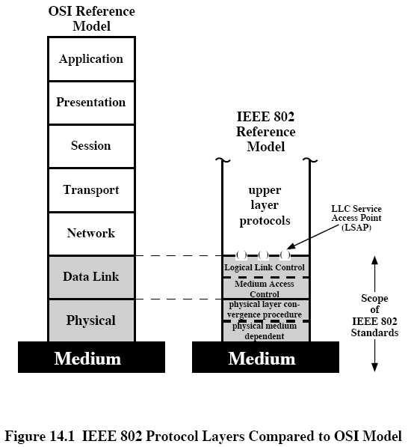
IEEE 802 Protocol Layers

Slide 96
Protocol Architecture
Functions of physical layer:
  Encoding/decoding of signals
  Preamble generation/removal (for synchronization)
  Bit transmission/reception
  Includes specification of the transmission medium

Slide 97
Protocol Architecture
Functions of medium access control (MAC) layer:
  On transmission, assemble data into a frame with address and error detection fields
  On reception, disassemble frame and perform address recognition and error detection
  Govern access to the LAN transmission medium
Functions of logical link control (LLC) Layer:
  Provide an interface to higher layers and perform flow and error control

Slide 98
Separation of LLC and MAC
The logic required to manage access to a shared-access medium not found in traditional layer 2 data link control
For the same LLC, several MAC options may be provided

Slide 99
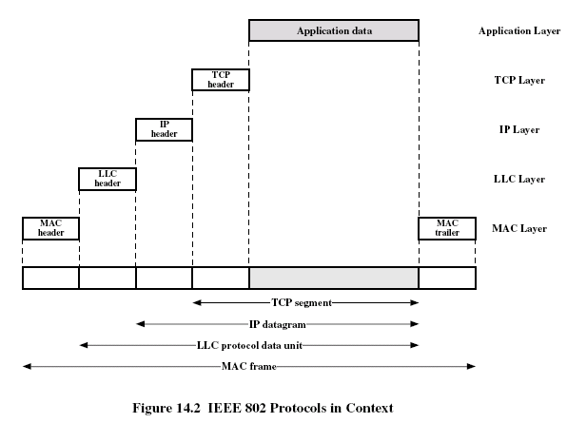

Slide 100
MAC Frame Format
MAC control
  Contains MAC protocol information
Destination MAC address
  Destination physical attachment point
Source MAC address
  Source physical attachment point
CRC
  Cyclic redundancy check

Slide 101
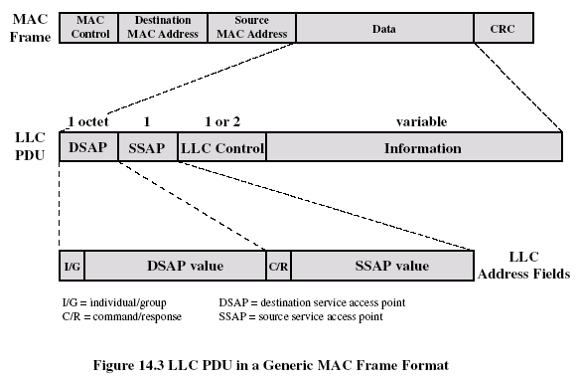

Slide 102
Logical Link Control
Characteristics of LLC not shared by other control protocols:
  Must support multiaccess, shared-medium nature of the link
  Relieved of some details of link access by MAC layer

Slide 103
LLC Services
Unacknowledged connectionless service
  No flow- and error-control mechanisms
  Data delivery not guaranteed
Connection-mode service
  Logical connection set up between two users
  Flow- and error-control provided
Acknowledged connectionless service
  Cross between previous two
  Datagrams acknowledged
  No prior logical setup

Slide 104
Differences between LLC and HDLC
LLC uses asynchronous balanced mode of operation of HDLC (type 2 operation)
LLC supports unacknowledged connectionless service (type 1 operation)
LLC supports acknowledged connectionless service (type 3 operation)
LLC permits multiplexing by the use of LLC service access points (LSAPs)

Slide 105
3.3.2 IEEE 802.11 Architecture and Services

Slide 106
3.3.2.1 The Wi-Fi Alliance
Wi-Fi: Wireless Fidelity
WECA: Wireless Ethernet Compatibility Alliance, an industry consortium formed in 1999

Slide 107
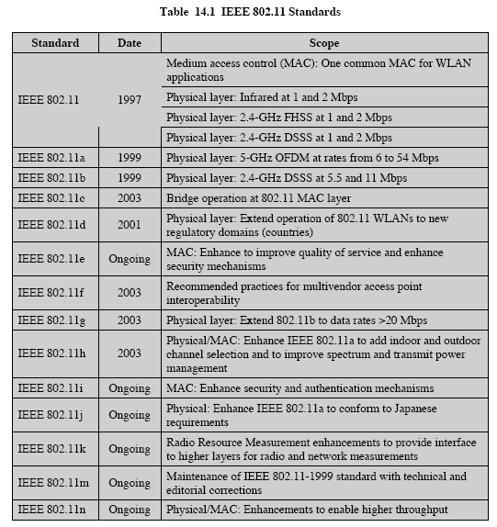

Slide 108
3.3.2.2 IEEE 802.11 Architecture
Distribution system (DS)
Access point (AP)
Basic service set (BSS)
  Stations competing for access to shared wireless medium
  Isolated or connected to backbone DS through AP
Extended service set (ESS)
  Two or more basic service sets interconnected by DS

Slide 109
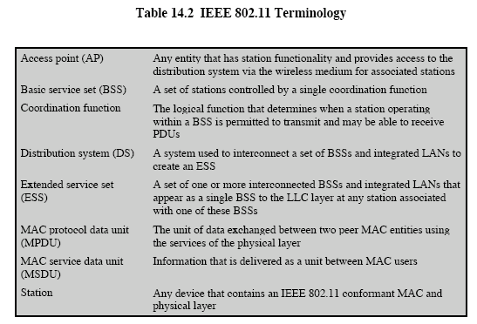

Slide 110
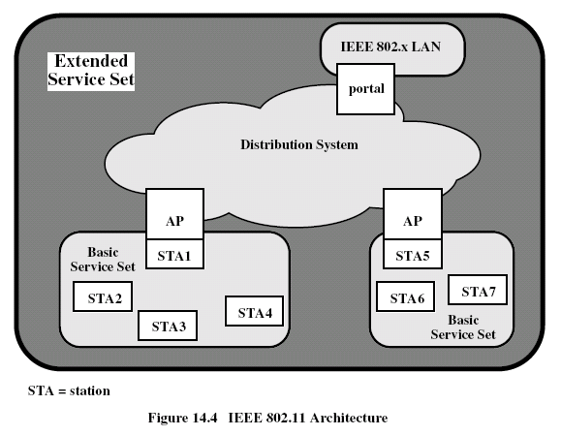

Slide 111
3.3.2.3 IEEE 802.11 Services

Slide 112
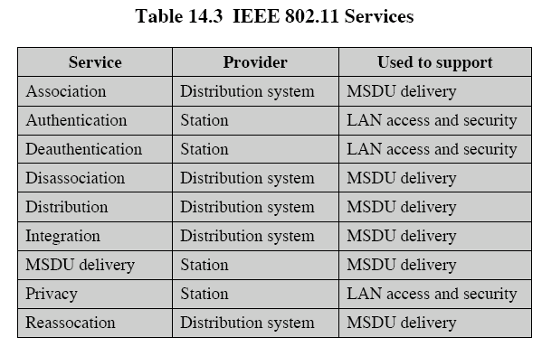

Slide 113
Distribution of Messages Within a DS
Distribution service
  Used to exchange MAC frames from station in one BSS to station in another BSS
Integration service
  Transfer of data between station on IEEE 802.11 LAN and station on integrated IEEE 802.x LAN

Slide 114
Transition Types Based On Mobility
No transition
  Stationary or moves only within BSS
BSS transition
  Station moving from one BSS to another BSS in same ESS
ESS transition
  Station moving from BSS in one ESS to BSS within another ESS

Slide 115
Association-Related Services
Association
  Establishes initial association between station and AP
Reassociation
  Enables transfer of association from one AP to another, allowing station to move from one BSS to another
Disassociation
  Association termination notice from station or AP

Slide 116
Access and Privacy Services
Authentication
  Establishes identity of stations to each other
Deathentication
  Invoked when existing authentication is terminated
Privacy
  Prevents message contents from being read by unintended recipient

Slide 117
3.3.3 802.11 Physical Layer

Slide 118
Overview
The physical layer for IEEE 802.11 has been issued in four stages.
802.11, 802.11a, 802.11b, 802.11g

Slide 119
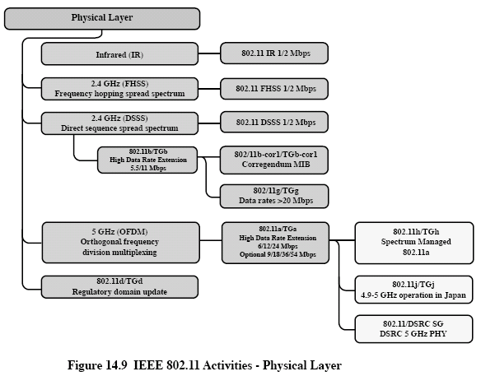

Slide 120
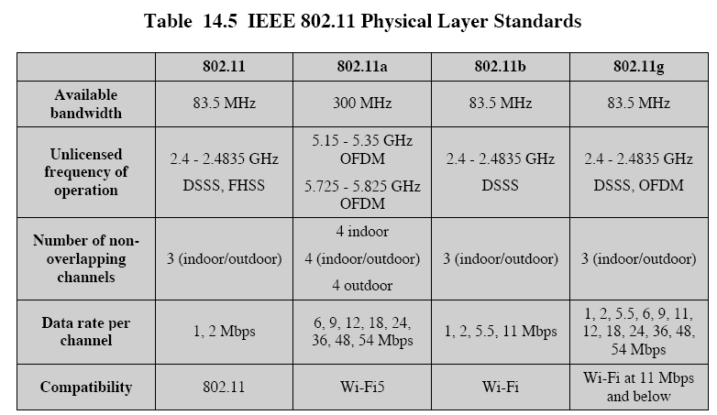

Slide 121
Original 802.11 Physical Layer
DSSS
FHSS
Infrared

Slide 122
Physical Media Defined by Original 802.11 Standard
Direct-sequence spread spectrum
  Operating in 2.4 GHz ISM band
  Data rates of 1 and 2 Mbps
Frequency-hopping spread spectrum
  Operating in 2.4 GHz ISM band
  Data rates of 1 and 2 Mbps
Infrared
  1 and 2 Mbps
  Wavelength between 850 and 950 nm

Slide 123
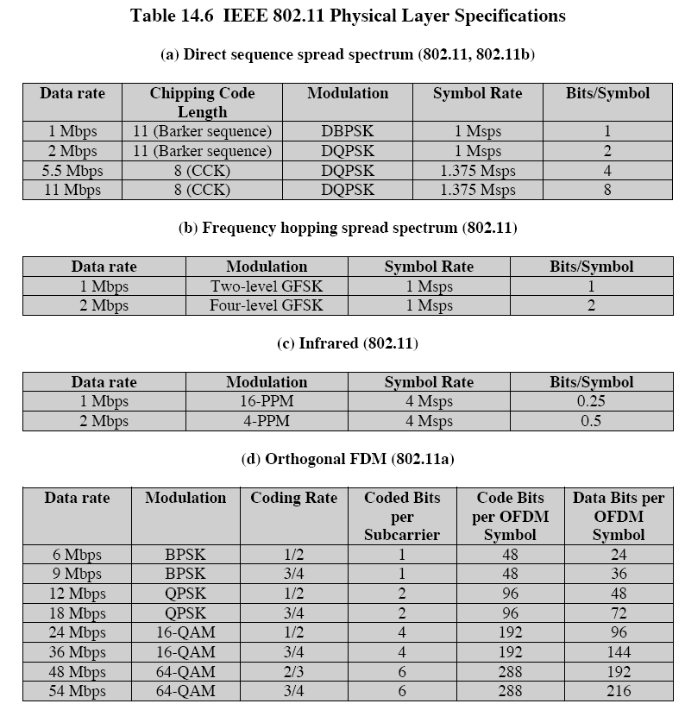

Slide 124
IEEE 802.11a
Channel Structure
Coding and Modulation
Physical-Layer Frame Structure

Slide 125
Channel Structure
802.11a makes use of the frequency band called the UNNI (Universal Networking Information Infrastructure)
UNNI includes UNNI-1(5.15-5.25GHz, indoor use), UNNI-2(5.25-5.35GHz, indoor or outdoor use), and UNNI-3(5.725-5.825GHz, outdoor use)

Slide 126
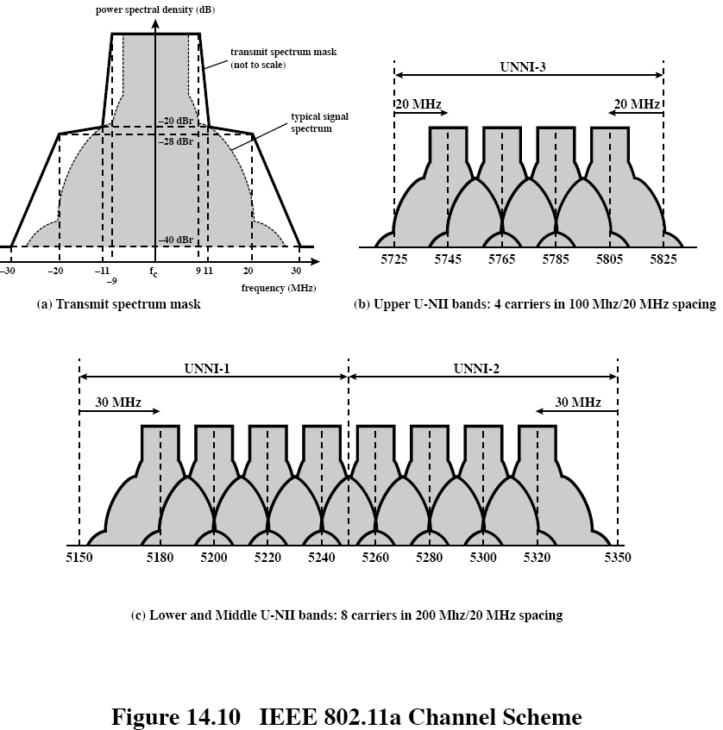

Slide 127
Coding and Modulation
OFDM: Orthogonal Frequency Division Multiplexing, uses multiple carrier signals at different frequencies, sending some of bits on each channel. Similar to FDM, However, in the case of OFDM, all of the subchannels are dedicated to a single data source.

Slide 128
Physical-Layer Frame Structure

Slide 129
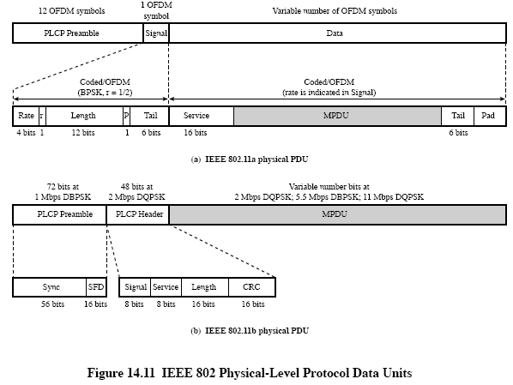

Slide 130
IEEE 802.11b
CCK Modulation Scheme
Physical-Layer Frame Structure (Fig. 14.11 (b))

Slide 131
CCK
802.11b is an extension of the 802.11 DSSS scheme, providing data rates of 5.5 and 11 Mbps in the ISM band.
Modulation scheme is CCK (Complementary code keying)

Slide 132
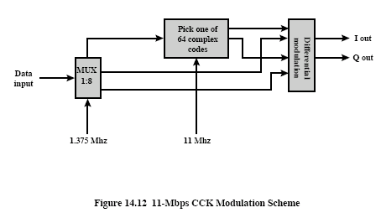

Slide 133
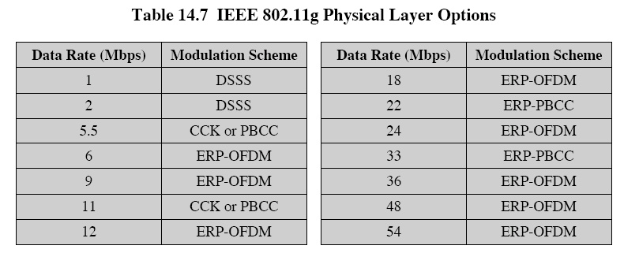
802.11g

Slide 134
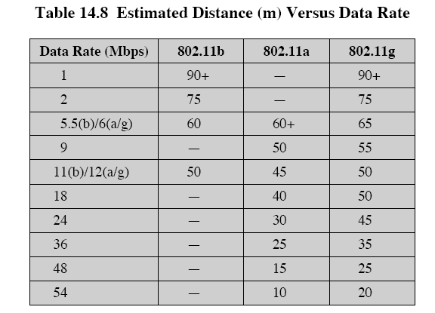
Speed vs Distance

Slide 135
3.3.4 Other IEEE 802.11 Standards
802.11c
802.11d
802.11e
802.11f
802.11h
802.11i
802.11k
802.11m
802.11n
802.11p
…

Slide 136
802.11c is concerned with bridge operation
802.11d deals with issues related to regulatory differences in various countries
802.11e makes revisions to the MAC layer to improve quality of service and address some security issues
802.11f addresses the issue of interoperability among access points (APs) from multiple vendors
802.11h deals with spectrum and power management issues

Slide 137
802.11i defines security and authentication mechanisms at the MAC layer
802.11k defines Radio Resource Management enhancements to provide mechanisms to higher layers for radio and network measurements
802.11m is an ongoing task group activity to correct editorial and technical issues in the standard
802.11n is studying a range of enhancements to both the physical and MAC layers to improve throughput

Slide 138
802.11p is an approved amendment to the IEEE 802.11 standard to add wireless access in vehicular environments (WAVE), a vehicular communication system.
Many other 802.11s available at
https://en.wikipedia.org/wiki/Category:IEEE_802.11

Slide 139
3.4 Bluetooth Techniques
Reading material:
[1]Investigation into Bluetooth Technology, Jean Parrend, Liverpool John Moores University

Slide 140
3.4.1 Overview
Universal short-range wireless capability
Uses 2.4-GHz band
Available globally for unlicensed users
Devices within 10 m can share up to 720 kbps of capacity
Supports open-ended list of applications
  Data, audio, graphics, video

Slide 141
Bluetooth Application Areas
Data and voice access points
  Real-time voice and data transmissions
Cable replacement
  Eliminates need for numerous cable attachments for connection
Ad hoc networking
  Device with Bluetooth radio can establish connection with another when in range

Slide 142
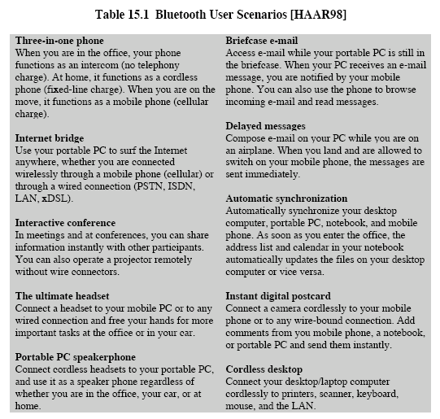

Slide 143
Bluetooth Standards Documents
Core specifications
  Details of various layers of Bluetooth protocol architecture
Profile specifications
  Use of Bluetooth technology to support various applications

Slide 144
Protocol Architecture
Bluetooth is a layered protocol architecture
  Core protocols
  Cable replacement and telephony control protocols
  Adopted protocols
Core protocols
  Radio
  Baseband
  Link manager protocol (LMP)
  Logical link control and adaptation protocol (L2CAP)
  Service discovery protocol (SDP)

Slide 145
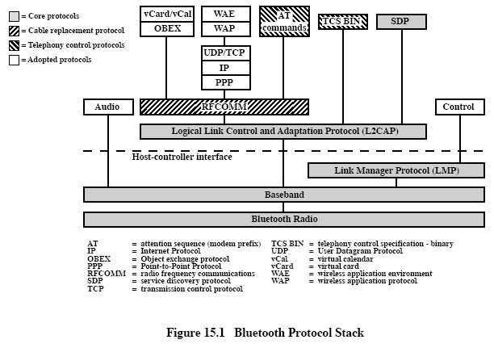

Slide 146
Protocol Architecture
Cable replacement protocol
  RFCOMM
Telephony control protocol
  Telephony control specification – binary (TCS BIN)
Adopted protocols
  PPP
  TCP/UDP/IP
  OBEX
  WAE/WAP

Slide 147
Usage Models
File transfer
Internet bridge
LAN access
Synchronization
Three-in-one phone
Headset

Slide 148
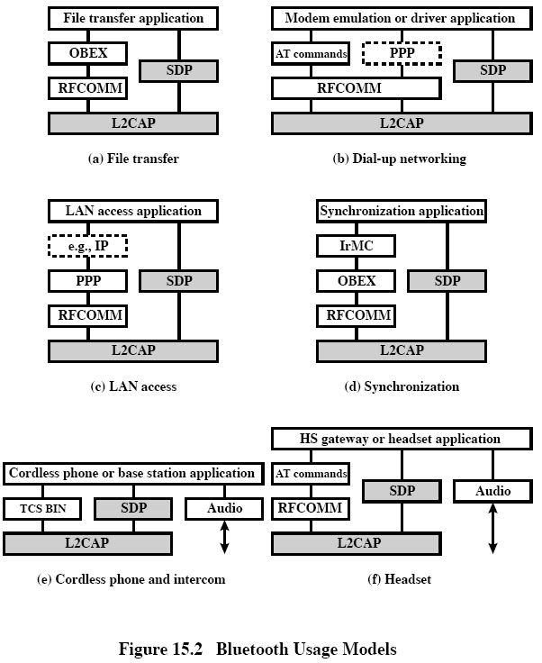

Slide 149
Piconets and Scatternets
Piconet
  Basic unit of Bluetooth networking
  Master and one to seven slave devices
  Master determines channel and phase
Scatternet
  Device in one piconet may exist as master or slave in another piconet
  Allows many devices to share same area
  Makes efficient use of bandwidth

Slide 150
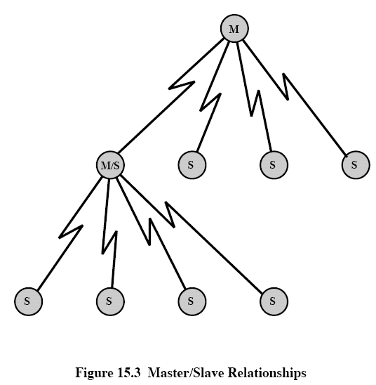

Slide 151
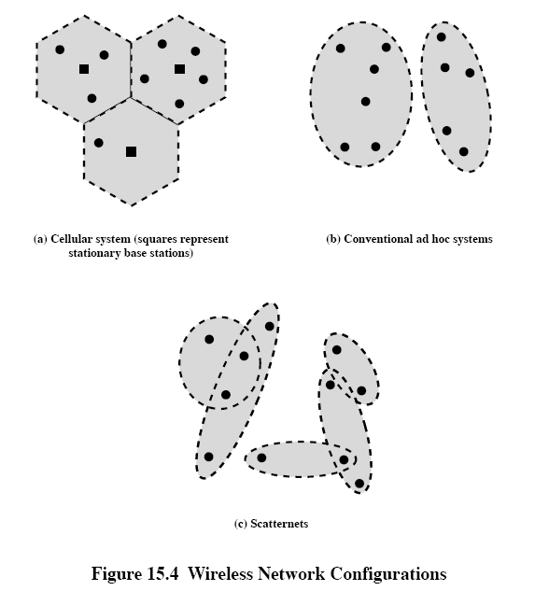

Slide 152
3.4.2 Radio Specification

Slide 153
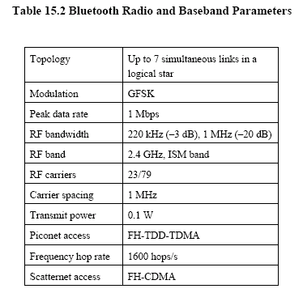

Slide 154
Classes of transmitters
Class 1: Outputs 100 mW for maximum range
  Power control mandatory
  Provides greatest distance
Class 2: Outputs 2.4 mW at maximum
  Power control optional
Class 3: Nominal output is 1 mW
  Lowest power

Slide 155
3.4.3 Baseband Specification

Slide 156
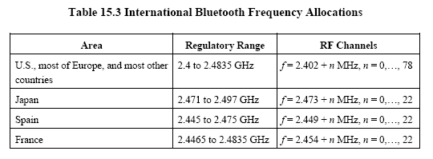

Slide 157
Frequency Hopping in Bluetooth
Provides resistance to interference and multipath effects
Provides a form of multiple access among co-located devices in different piconets

Slide 158
Frequency Hopping
Total bandwidth divided into 1MHz physical channels
FH occurs by jumping from one channel to another in pseudorandom sequence; The FH sequence is determined by the master in a piconet and is a function of the master’s Bluetooth address
Hopping sequence shared with all devices on piconet
Piconet access:
  Bluetooth devices use time division duplex (TDD)
  Access technique is TDMA
  FH-TDD-TDMA

Slide 159
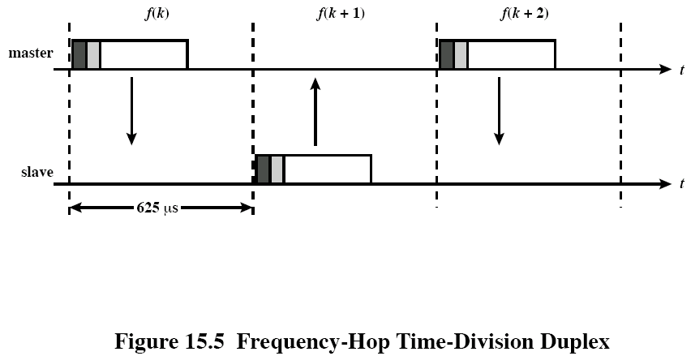
Frequency Hopping

Slide 160
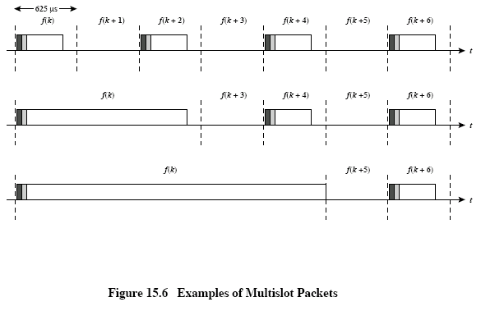

Slide 161
Physical Links between Master and Slave
Synchronous connection oriented (SCO)
  Allocates fixed bandwidth between point-to-point connection of master and slave
  Master maintains link using reserved slots
  Master can support three simultaneous links
Asynchronous connectionless (ACL)
  Point-to-multipoint link between master and all slaves
  Only single ACL link can exist

Slide 162
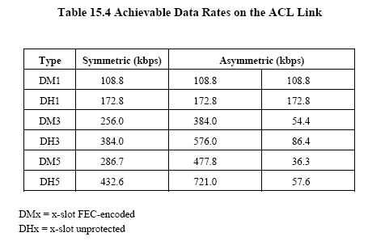

Slide 163
Bluetooth Packet Fields
Access code – used for timing synchronization, offset compensation, paging, and inquiry
Header – used to identify packet type and carry protocol control information
Payload – contains user voice or data and payload header, if present

Slide 164
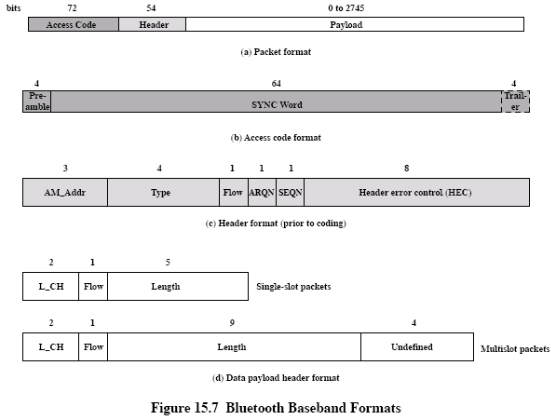

Slide 165
Types of Access Codes
Channel access code (CAC) – identifies a piconet
Device access code (DAC) – used for paging and subsequent responses
Inquiry access code (IAC) – used for inquiry purposes

Slide 166
Access Code
Preamble – used for DC compensation
  0101 if LSB of sync word is 0
  1010 if LSB of synch word is 1
Sync word – 64-bits, derived from:
  7-bit Barker sequence; including a bit in LAP
  Lower address part (LAP); 24bits; each Bluetooth device is assigned a globally unique 48-bit address
  Pseudonoise (PN) sequence; 64 bits but using 30 bits
  Taking the bitwise (LAP + Baker code), PN, and data to obtain the scrambled information; adding 34 check bits with BCH and taking the bitwise XOR with PN
Trailer
  0101 if MSB of sync word is 1
  1010 if MSB of sync word is 0

Slide 167
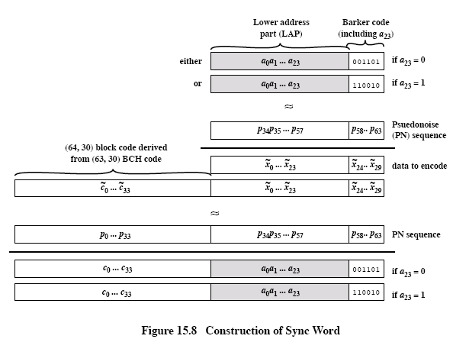

Slide 168
Packet Header Fields
AM_ADDR – contains “active mode” address of one of the slaves; temporary address assigned to a slave in this piconet
Type – identifies type of packet (Table 15.5); HVx packets carry 64-kbps voice with different amounts of error protection; DV packets carry both voice and data, DMx or DHx packets carry data (Table 15.4)
Flow – 1-bit flow control; for ACL traffic only
ARQN – 1-bit acknowledgment; for ACL traffic protected by a CRC (Table 15.5)
SEQN – 1-bit sequential numbering schemes
Header error control (HEC) – 8-bit error detection code

Slide 169
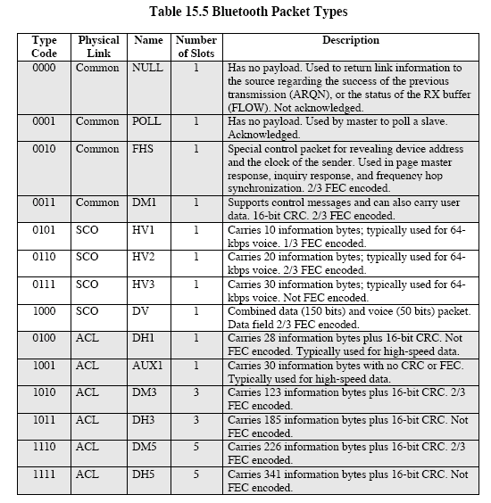

Slide 170
Payload Format
Payload header
  L_CH field – identifies logical channel
  Flow field – used to control flow at L2CAP level
  Length field – number of bytes of data
Payload body – contains user data
CRC – 16-bit CRC code

Slide 171
Error Correction Schemes
1/3 rate FEC (forward error correction)
  Used on 18-bit packet header, voice field in HV1 packet
2/3 rate FEC
  Used in DM packets, data fields of DV packet, FHS packet and HV2 packet
ARQ
  Used with DM and DH packets

Slide 172
ARQ Scheme Elements
Error detection – destination detects errors, discards packets
Positive acknowledgment – destination returns positive acknowledgment
Retransmission after timeout – source retransmits if packet unacknowledged
Negative acknowledgment and retransmission – destination returns negative acknowledgement for packets with errors, source retransmits

Slide 173
Fast ARQ
Bluetooth uses the fast ARQ scheme, which takes advantage of the fact that a master and slave communicate in alternate time slots
Fig. 15.9 illustrates the technique
Fig. 15.10 shows the ARQ mechanism in more detail

Slide 174
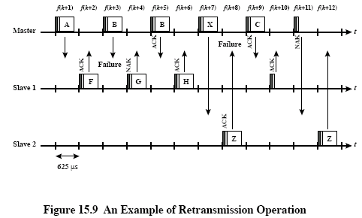

Slide 175
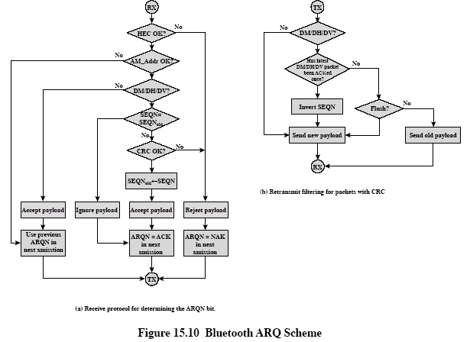

Slide 176
Logical Channels
Link control (LC)
Link manager (LM)
User asynchronous (UA)
User isochronous (UI)
User synchronous (US)

Slide 177
Logical Channels—LC
Used to manage the flow of packets over the link interface. The LC channel is mapped onto the packet header. This channel carries low-level link control information like ARQ, flow control, and payload characterization. The LC channel is carried in every packet except in the ID packet, which has no packet header

Slide 178
Logical Channels—LM
Transports link management information between participating stations. This logical channel supports LMP traffic and can be carried over either an SCO or ACL link

Slide 179
Logical Channels—UA
Carries asynchronous user data. This channel is normally carried over the ACL link but may be carried in a DV packet on the SCO link

Slide 180
Logical Channels—UI
Carries isochronous user data, which recurs with known periodic timing. This channel is normally carried over the ACL link but may be carried in a DV packet on the SCO link. At the baseband level, the UI channel is treated the same way as a UA channel. Timing to provide isochronous properties is provided at a higher layer

Slide 181
Logical Channels—US
Carries synchronous user data. This channel is carried over the SCO link

Slide 182
Channel Control
States of operation of a piconet during link establishment and maintenance
Major states
  Standby – default state
  Connection – device connected

Slide 183
Channel Control
Interim substates for adding new slaves
  Page – device issued a page (used by master)
  Page scan – device is listening for a page
  Master response – master receives a page response from slave
  Slave response – slave responds to a page from master
  Inquiry – device has issued an inquiry for identity of devices within range
  Inquiry scan – device is listening for an inquiry
  Inquiry response – device receives an inquiry response

Slide 184
Inquiry Procedure
Potential master identifies devices in range that wish to participate
  Transmits ID packet with inquiry access code (IAC)
  Occurs in Inquiry state
Device receives inquiry
  Enter Inquiry Response state
  Returns FHS packet with address and timing information
  Moves to page scan state

Slide 185
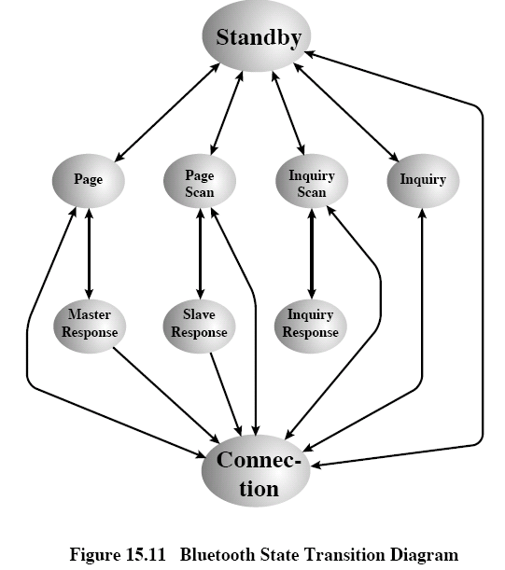

Slide 186
Page Procedure
Master uses devices address to calculate a page frequency-hopping sequence
Master pages with ID packet and device access code (DAC) of specific slave
Slave responds with DAC ID packet
Master responds with its FHS packet
Slave confirms receipt with DAC ID
Slaves moves to Connection state

Slide 187
Slave Connection State Modes
Active – participates in piconet
  Listens, transmits and receives packets
Sniff – only listens on specified slots
Hold – does not support ACL packets
  Reduced power status
  May still participate in SCO exchanges
Park – does not participate on piconet
  Still retained as part of piconet

Slide 188
Bluetooth Audio
Voice encoding schemes:
  Pulse code modulation (PCM)
  Continuously variable slope delta (CVSD) modulation
Choice of scheme made by link manager
  Negotiates most appropriate scheme for application

Slide 189
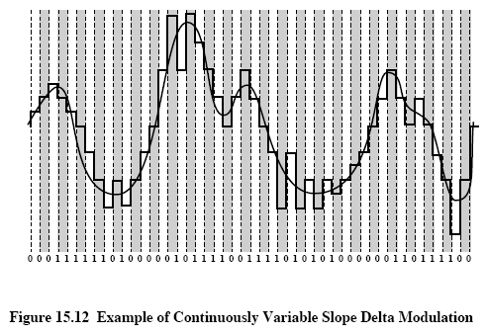

Slide 190
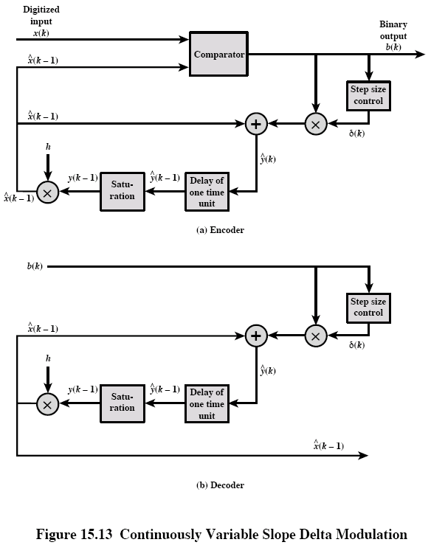

Slide 191
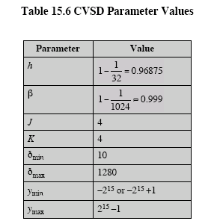

Slide 192
3.4.4 Link Manager Specification

Slide 193
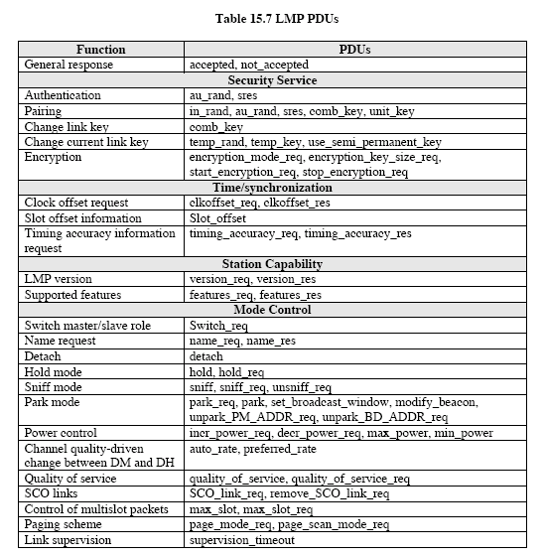

Slide 194
LMP PDUs
General response
Security Service
  Authentication
  Pairing
  Change link key
  Change current link key
  Encryption

Slide 195
LMP PDUs
Time/synchronization
  Clock offset request
  Slot offset information
  Timing accuracy information request
Station capability
  LMP version
  Supported features

Slide 196
LMP PDUs
Mode control
  Switch master/slave role
  Name request
  Detach
  Hold mode
  Sniff mode
  Park mode
  Power control

Slide 197
LMP PDUs
Mode control (cont.)
  Channel quality-driven change between DM and DH
  Quality of service
  Control of multislot packets
  Paging scheme
  Link supervision

Slide 198
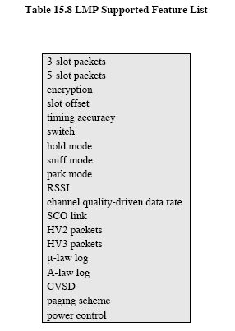

Slide 199
3.4.5 Logical Link Control and Adaptation Protocol

Slide 200
L2CAP
Provides a link-layer protocol between entities with a number of services
Relies on lower layer for flow and error control
Makes use of ACL links, does not support SCO links
Provides two alternative services to upper-layer protocols
  Connection service
  Connection-mode service

Slide 201
L2CAP Logical Channels
Connectionless
  Supports connectionless service
  Each channel is unidirectional
  Used from master to multiple slaves
Connection-oriented
  Supports connection-oriented service
  Each channel is bidirectional
Signaling
  Provides for exchange of signaling messages between L2CAP entities

Slide 202
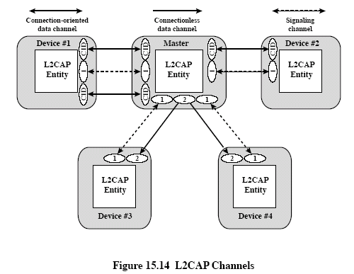

Slide 203
L2CAP Packet Fields for Connectionless Service
Length – length of information payload, PSM fields
Channel ID – 2, indicating connectionless channel
Protocol/service multiplexer (PSM) – identifies higher-layer recipient for payload
  Not included in connection-oriented packets
Information payload – higher-layer user data

Slide 204
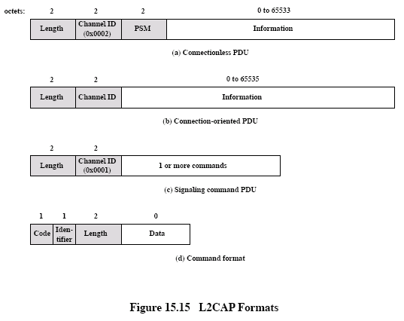

Slide 205
Signaling Packet Payload
Consists of one or more L2CAP commands, each with four fields
  Code – identifies type of command
  Identifier – used to match request with reply
  Length – length of data field for this command
  Data – additional data for command, if necessary

Slide 206
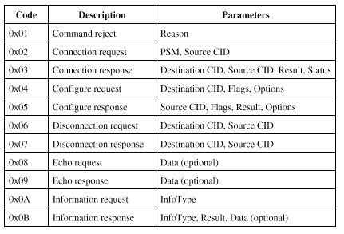
L2CAP Signaling Command Codes

Slide 207
L2CAP Signaling Commands
Command reject command
  Sent to reject any command
Connection commands
  Used to establish new connections
Configure commands
  Used to establish a logical link transmission contract between two L2CAP entities

Slide 208
L2CAP Signaling Commands
Disconnection commands
  Used to terminate logical channel
Echo commands
  Used to solicit response from remote L2CAP entity
Information commands
  Used to solicit implementation-specific information from remote L2CAP entity

Slide 209
Flow Specification Parameters
Service type
Token rate (bytes/second)
Token bucket size (bytes)
Peak bandwidth (bytes/second)
Latency (microseconds)
Delay variation (microseconds)

Slide 210
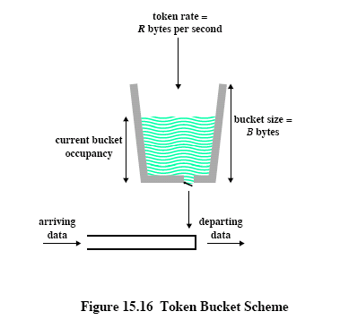

Slide 211
3.4.6 IEEE 802.15

Slide 212
WPAN
802.15 is for short range WPANs (Wireless Personal Area Networks)
A PAN is communication network within a small area in which all of the devices on the network are typically owned by one person or perhaps a family

Slide 213
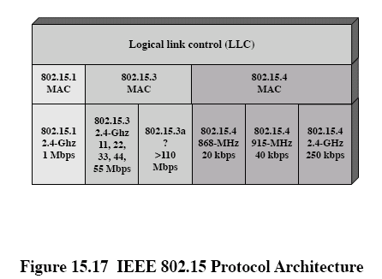

Slide 214
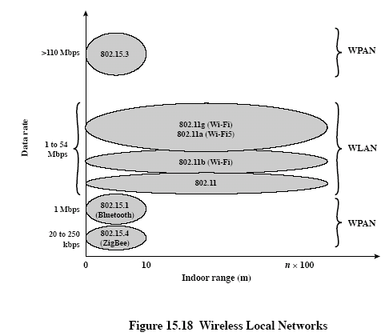

Slide 215
IEEE 802.15.3
Concerned with the high data rate WPANs

Slide 216
Examples of Applications
Connecting digital still cameras to printers or kiosks
Laptop to projector connection
Connecting a personal digital assistant (PDA) to a camera or PDA to a printer
Speakers in a 5:1 surround-sound system connecting to the receiver
Video distribution from a set-top box or cable modem
Sending music from a CD or MP3 player to headphones or speakers
Video camera display on television
Remote view finders for video or digital still cameras

Slide 217
Requirements of Applications
Short range: 10m
High throughput: greater than 20 Mbps
Low power usage
Low cost
QoS capable
Dynamic environment: for mobile device, a speed of less than 7 km/h is addressed
Simple connectivity
privacy

Slide 218
MAC of 802.15.3
An 802.15.3 network consists of a collection of devices (DEVs).
One of the DEVs also acts as a piconet coordinator (PNC)
The PNC assigns time for connections between DEVs
All commands are between the PNC and DEVs
The PNC is used to control access to the time resources of the piconet and is not involved in the exchange of data frames between DEVs

Slide 219
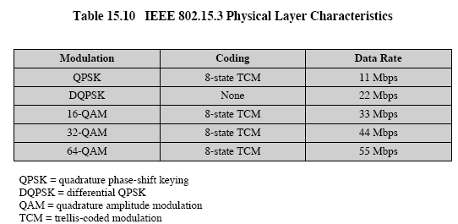
Physical Layer of 802.15.3

Slide 220
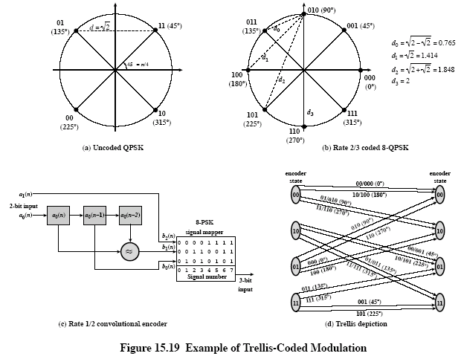

Slide 221
IEEE 802.15.3a
Provides a higher speed (110Mbps or greater) PHY amendment to the draft P802.15.3 standard
The new PHY will use the P802.15.3 MAC with limited modification

Slide 222
IEEE 802.15.4
Investigates a low data solution with mutimonth to multiyear battery life and very low complexity
PHYs: 868 MHz/915 MHz DSSS, 2.4 GHz DSSS

